Slide 2
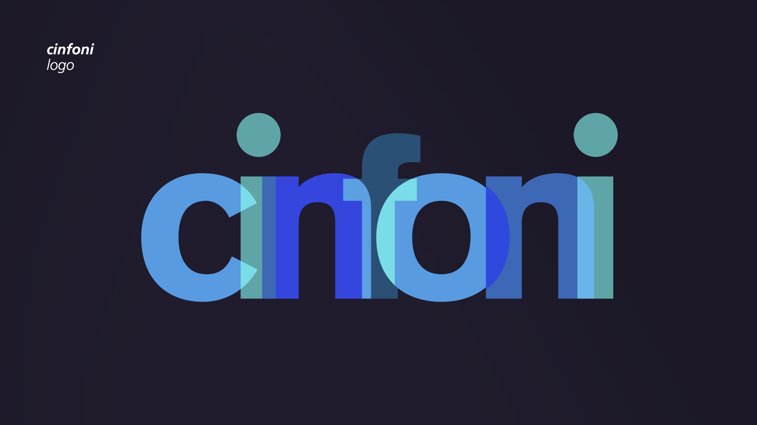

Slide 3
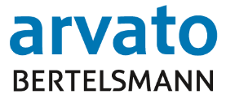
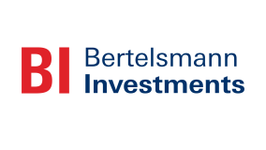
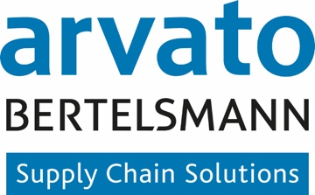
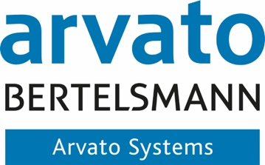
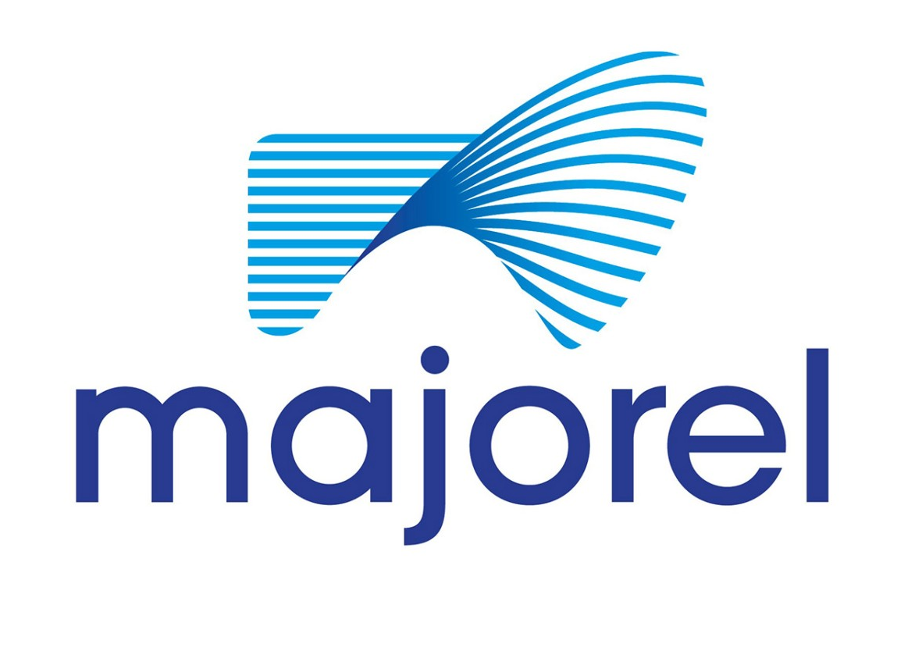
A Strong Network for Financial Services (FS) Bertelsmann and Arvato Affiliations Provide Unique Value for FS
Shareholder Structure
80.9% Charitable Foundations 19.1% Mohn Family
Revenue | €17.7bn
Operating EBITDA | €2.59bn
Employees | 117,220
Parent Company
Divisions of BERTELSMANN
Revenue | €4.1bn
Employees | >75,000
Countries | 40+
Solution Lines of Arvato
BFS finance GmbH
2018
Notes:
This slide shouldn’t be explained from a strict organizational structure perspective, but it is more about showing the value of this network for the client:
Bertelsmann network: Backed by privately-owned Bertelsmann, we can afford to take a long-term view and invest in long-term strategies and partnerships (capital intensity, network, international know-how)
Arvato Group: As we combine different service sectors, the Arvato group is more than just another international service provider. We’ve got an ear to the ground in all our solution groups in every industry and an eye to the future enabling a holistic view and insights on all our activities. Therefore, we’re the ones who don’t just deliver, but collaborate to design and implement holistic solutions that make a lasting impact on clients’ businesses.

Slide 4
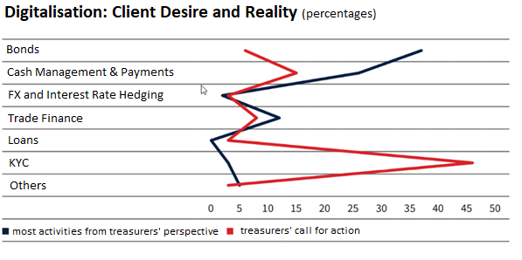
The Onboarding Challenge Financial Institutions Suffer from Constantly Increasing Regulatory Requirements
More than 45% of treasurers call for action in the field of digitization of KYC processes.¹⁾
KYC Trouble: Treasurers are willing to change banks²⁾
Treasurers call for coordinated approach to KYC requests²⁾
Why BFS finance GmbH
Regulated financial institution as part of the Bertelsmann Group
Bertelsmann as corporate customer is directly affected "KYC Sufferer”
Arvato as International Service Group
Arvato Systems with strong competences and partnerships in the Fintech/ Regtech industry
1) Source (translated): Der Treasurer, Treasurer-Panel, November 2018, Banken-Digitalisierungsaktivitäten
2) Source: Finance Magazin (23.04.2018)
Notes:
This slide shouldn’t be explained from a strict organizational structure perspective, but it is more about showing the value of this network for the client:
Bertelsmann network: Backed by privately-owned Bertelsmann, we can afford to take a long-term view and invest in long-term strategies and partnerships (capital intensity, network, international know-how)
Arvato Group: As we combine different service sectors, the Arvato group is more than just another international service provider. We’ve got an ear to the ground in all our solution groups in every industry and an eye to the future enabling a holistic view and insights on all our activities. Therefore, we’re the ones who don’t just deliver, but collaborate to design and implement holistic solutions that make a lasting impact on clients’ businesses.

Slide 5
Cinfoni Acts as Single-Point-of-Contact, to Help Corporates With their Duty of Cooperation and Banks to Fulfil their KYC/Regulatory Requirements
Current Situation
Cinfoni
Recurring obligations
Cinfoni Network
Corporate 1
Bank 1
Corporate 1
Bank 1
Diverging requirements
G
G
Corporate …
Bank …
Corporate …
Bank …
Corporate n
Bank m
Corporate n
Bank m
Current KYC processes are performed by each bank individually leading to:
Low degree of standardization and automation
Lack of (data) transparency and poor data quality
Frequent customer outreach to retrieve all necessary information
High degree of manual effort leading to long onboarding times and high costs
Multiple processing of a corporate client’s data within a bank as well as across banks
Cinfoni Network as single-point-of-contact for banks and corporate clients thus centralizing data collection, aggregation and validation processes:
High degree of standardization and automation
The centralized cinfoni platform ensures that individual bank forms are no longer necessary
Continuous outreach related to KYC requests by banks are eliminated due to one-time completion of corporate master data
Corporates enable their corporate data wallet individually for each bank
The platform approach shortens the onboarding and review process
Cinfoni is free for corporate clients
Notes:
This slide shouldn’t be explained from a strict organizational structure perspective, but it is more about showing the value of this network for the client:
Bertelsmann network: Backed by privately-owned Bertelsmann, we can afford to take a long-term view and invest in long-term strategies and partnerships (capital intensity, network, international know-how)
Arvato Group: As we combine different service sectors, the Arvato group is more than just another international service provider. We’ve got an ear to the ground in all our solution groups in every industry and an eye to the future enabling a holistic view and insights on all our activities. Therefore, we’re the ones who don’t just deliver, but collaborate to design and implement holistic solutions that make a lasting impact on clients’ businesses.

Slide 6
Benefits: Better Compliance, Lower Costs, Strong Customer Convenience Financial services providers must spend a total of 43 billion US dollars per year on AML compliance¹⁾, Treasurers have huge efforts
+
+
+
70% operational
Savings for corporates and banks
Onboarding:
6 weeks -> 2 days on avg.
Digital product
enablement
EFFORT COSTS TIME
CUSTOMER CONVENIENCE
DIGITAL ENABLEMENT
REGULATORY RISK
80%
on corporates
side
26 billion US$²⁾ worldwide in fines for non-compliance
with KYC, AML and sanctions regulations
-
-
Source: https://www.presseportal.ch/de/pm/100060821/100810129
Source: Deloitte KYC Study
Notes:
This slide shouldn’t be explained from a strict organizational structure perspective, but it is more about showing the value of this network for the client:
Bertelsmann network: Backed by privately-owned Bertelsmann, we can afford to take a long-term view and invest in long-term strategies and partnerships (capital intensity, network, international know-how)
Arvato Group: As we combine different service sectors, the Arvato group is more than just another international service provider. We’ve got an ear to the ground in all our solution groups in every industry and an eye to the future enabling a holistic view and insights on all our activities. Therefore, we’re the ones who don’t just deliver, but collaborate to design and implement holistic solutions that make a lasting impact on clients’ businesses.

Slide 7
Cinfoni Platform Luxembourg – Increasing Transparency and Control Through Centralized Data Creation and Management of Regulatory Data Records for Luxembourg
Bank 1
Bank …
Bank n
Corporate
Corporate
First use of cinfoni
Delivery of Corporate Data Record
Onboarding of further banks and update process
02
Check and approval of data
BFS finance GmbH
Outsourcing by a “born” third party (regulated entity)
02
Check and approval of data
Bank-specific data
Automated data enhancement and validation by cinfoni
Automated data enhancement and validation by cinfoni
Common on-top data
Regulatory data
01
One-time: Self-disclosure of data
01
Not applicable anymore
Cinfoni Platform Luxembourg
Notes:
This slide shouldn’t be explained from a strict organizational structure perspective, but it is more about showing the value of this network for the client:
Bertelsmann network: Backed by privately-owned Bertelsmann, we can afford to take a long-term view and invest in long-term strategies and partnerships (capital intensity, network, international know-how)
Arvato Group: As we combine different service sectors, the Arvato group is more than just another international service provider. We’ve got an ear to the ground in all our solution groups in every industry and an eye to the future enabling a holistic view and insights on all our activities. Therefore, we’re the ones who don’t just deliver, but collaborate to design and implement holistic solutions that make a lasting impact on clients’ businesses.

Slide 8
Demo Customer Portal
Notes:
This slide shouldn’t be explained from a strict organizational structure perspective, but it is more about showing the value of this network for the client:
Bertelsmann network: Backed by privately-owned Bertelsmann, we can afford to take a long-term view and invest in long-term strategies and partnerships (capital intensity, network, international know-how)
Arvato Group: As we combine different service sectors, the Arvato group is more than just another international service provider. We’ve got an ear to the ground in all our solution groups in every industry and an eye to the future enabling a holistic view and insights on all our activities. Therefore, we’re the ones who don’t just deliver, but collaborate to design and implement holistic solutions that make a lasting impact on clients’ businesses.

Slide 9
Open Cinfoni Network Exchange Models & Roles of Network Participants
Corporate clients
Financial institutions
Data providers
Regulators
Network nodes (e.g. cinfoni platform Luxembourg)
Definition of cinfoni local/ regional regulatory standards
Committing to cinfoni standards
Providing ‘best-effort’ data records
Data transfer
Monitoring KYC compliance
Int. Transfer of Records
Regulatory Operating Unit (ROU)
Bank Specific Service
P2P Network
blueprint by BFS finance e.g. cinfoni platform Germany
e.g. banking specific onboarding & reviews with leverage into network
e.g. direct transfer of corporate data record in a P2P network, supported by BFS finance
Notes:
This slide shouldn’t be explained from a strict organizational structure perspective, but it is more about showing the value of this network for the client:
Bertelsmann network: Backed by privately-owned Bertelsmann, we can afford to take a long-term view and invest in long-term strategies and partnerships (capital intensity, network, international know-how)
Arvato Group: As we combine different service sectors, the Arvato group is more than just another international service provider. We’ve got an ear to the ground in all our solution groups in every industry and an eye to the future enabling a holistic view and insights on all our activities. Therefore, we’re the ones who don’t just deliver, but collaborate to design and implement holistic solutions that make a lasting impact on clients’ businesses.

Slide 10
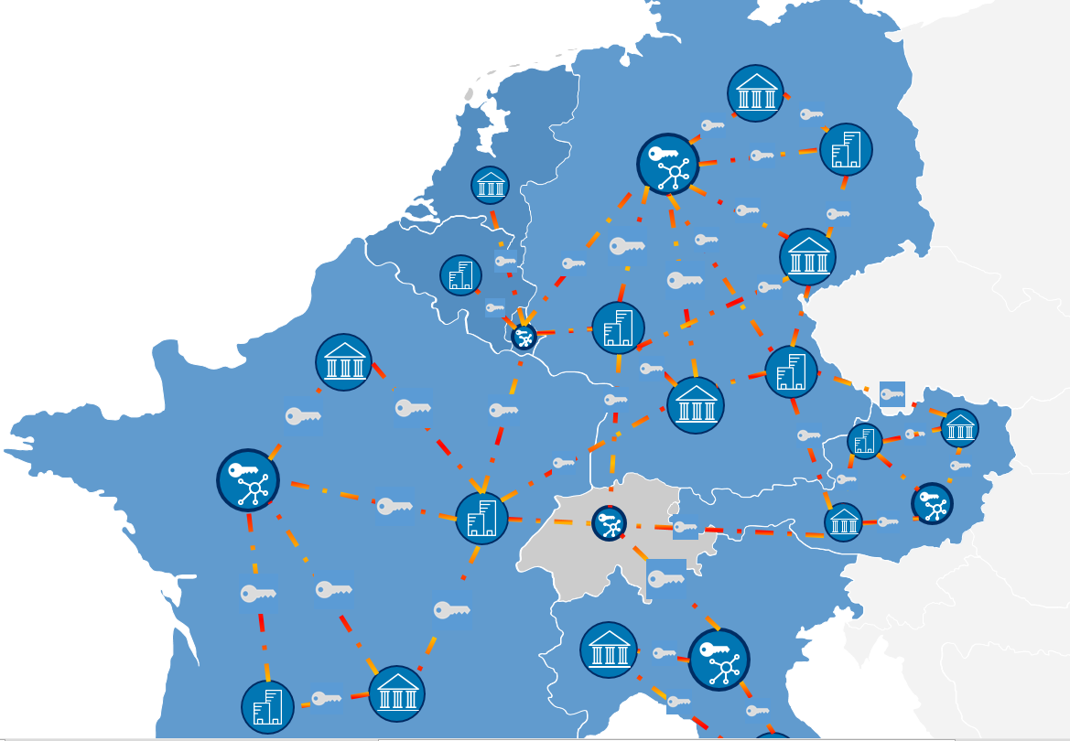
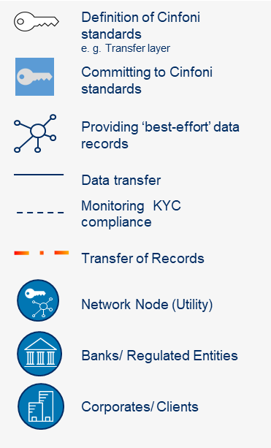
One European Network under the Cinfoni Umbrella
Key Benefits
European Network
You, as a CORPORATE, can choose where to store your data according to GDPR rules
High level of EU standardisation for customers and financial institutions including multiple jurisdictions
Standards of regional “best-effort” data record transfer defined by national and EU advisory boards
Transfer of data records between multiple EU jurisdictions is simplified due to international data transfer standards within cinfoni
Notes:
This slide shouldn’t be explained from a strict organizational structure perspective, but it is more about showing the value of this network for the client:
Bertelsmann network: Backed by privately-owned Bertelsmann, we can afford to take a long-term view and invest in long-term strategies and partnerships (capital intensity, network, international know-how)
Arvato Group: As we combine different service sectors, the Arvato group is more than just another international service provider. We’ve got an ear to the ground in all our solution groups in every industry and an eye to the future enabling a holistic view and insights on all our activities. Therefore, we’re the ones who don’t just deliver, but collaborate to design and implement holistic solutions that make a lasting impact on clients’ businesses.

Slide 11
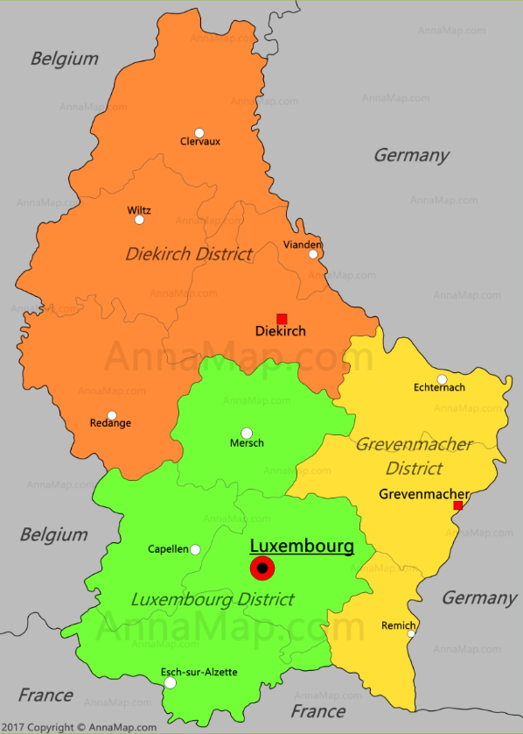
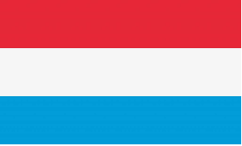
The CORPORATE Decides Where to Store Regulatory Data According to GDPR Rules
Corporate with subsidiaries
Single Network Node
Multiple International Network Nodes
Cinfoni Platform Luxembourg
Corporate Wallet Luxembourg
National Cinfoni Platforms
National Corporate Wallets
Notes:
This slide shouldn’t be explained from a strict organizational structure perspective, but it is more about showing the value of this network for the client:
Bertelsmann network: Backed by privately-owned Bertelsmann, we can afford to take a long-term view and invest in long-term strategies and partnerships (capital intensity, network, international know-how)
Arvato Group: As we combine different service sectors, the Arvato group is more than just another international service provider. We’ve got an ear to the ground in all our solution groups in every industry and an eye to the future enabling a holistic view and insights on all our activities. Therefore, we’re the ones who don’t just deliver, but collaborate to design and implement holistic solutions that make a lasting impact on clients’ businesses.

Slide 12
Cinfoni
Dr. Paul-Gerhard Haase
Jan Becker
Member of the Executive Board
BFS finance GmbH
Gütersloher Straße 123
GER-33415 Verl
Phone: +49 151 461 59151
Mail: Paul-Gerhard.Haase@arvato.com
finance.arvato.com
Senior Project Manager
BFS finance GmbH
Gütersloher Straße 123
GER-33415 Verl
Phone: +49 5241 80 43538
Mail: Jan.Becker@arvato.com
finance.arvato.com
An International Regulatory-Driven Customer Information Exchange Network for Corporates and FIs
December 2019
The information contained in this presentation is confidential information of Arvato Financial Solutions. The information must always be treated strictly confidential, not passed on to third parties and used exclusively for the purpose of checking our offer and deciding on the award of the contract. In particular, other information benefits or other economic benefits must not be derived from the information and documents received. The information may only be made available to employees and consultants who require knowledge in the course of preparing the decision on the award of the contract and who are – legally or contractually – obliged to maintain confidentiality. This group of people should be kept as small as possible. Copies may only be made with the consent of Arvato Financial Solutions. Our offer is neither explicit nor implied as a transfer of rights or as a granting of a license with regard to the information contained in the offer. The obligation to maintain secrecy shall continue for an indefinite period.

Slide 13
Backup
Notes:
This slide shouldn’t be explained from a strict organizational structure perspective, but it is more about showing the value of this network for the client:
Bertelsmann network: Backed by privately-owned Bertelsmann, we can afford to take a long-term view and invest in long-term strategies and partnerships (capital intensity, network, international know-how)
Arvato Group: As we combine different service sectors, the Arvato group is more than just another international service provider. We’ve got an ear to the ground in all our solution groups in every industry and an eye to the future enabling a holistic view and insights on all our activities. Therefore, we’re the ones who don’t just deliver, but collaborate to design and implement holistic solutions that make a lasting impact on clients’ businesses.

Slide 14
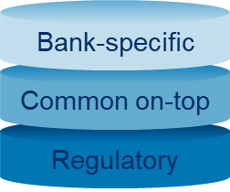
The CORPORATE Decides Where to Store Regulatory Data According to GDPR Rules
Corporate with subsidiaries
Single Network Node (Corporate Wallet)
Single Network Node (Cinfoni Platform Luxembourg)
Multiple Network Nodes (Corporate Wallet)
Multiple International Network Nodes (National Cinfoni Platforms)
Notes:
This slide shouldn’t be explained from a strict organizational structure perspective, but it is more about showing the value of this network for the client:
Bertelsmann network: Backed by privately-owned Bertelsmann, we can afford to take a long-term view and invest in long-term strategies and partnerships (capital intensity, network, international know-how)
Arvato Group: As we combine different service sectors, the Arvato group is more than just another international service provider. We’ve got an ear to the ground in all our solution groups in every industry and an eye to the future enabling a holistic view and insights on all our activities. Therefore, we’re the ones who don’t just deliver, but collaborate to design and implement holistic solutions that make a lasting impact on clients’ businesses.

