Slide 1
FX and trade wars – The new world order
CURRENCIES
GLOBAL
CURRENCIES – June 2019
David Bloom
Global Head of FX Research
HSBC Bank plc
david.bloom@hsbcib.com
+44 20 7991 5969
Issuer of report: HSBC Bank plc

Slide 2
2.
Structural, cyclical and political
Structural
Fed QE – 1, 2, 3
Debt-to-GDP matters
Fiscal debate – does austerity help?
Eurozone debt crisis
Politics
Japan: Abe elected
India: Modi elected
BRL, TRY, ZAR
UK: Brexit vote
US: Trump elected
Cyclical
ECB – tapering
BoC raises rates
BoE raises rates
Source: HSBC

Slide 3
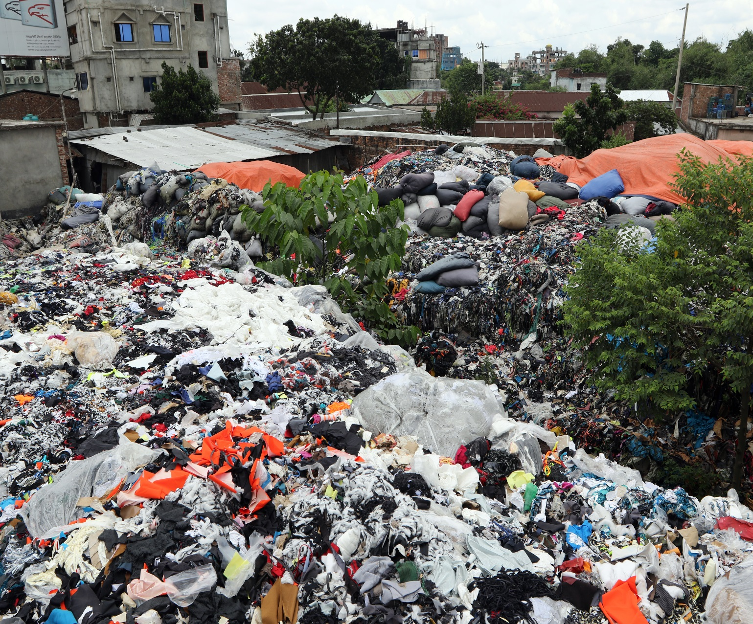


3.
Dollar – a bad hotel
Source: Getty Images

Slide 4
4.
Dollar – better than elsewhere
Source: Getty Images

Slide 5
5.
Market expectations for G10 rates have dropped
bp
Change in market rate exp. since December Fed
bp
0
0
-10
-10
-20
-20
-30
-30
-40
-40
-50
-50
-60
-60
-70
-70
-80
-80
-90
-90
-100
-100
USD
AUD
NZD
CAD
GBP
EUR
CHF
SEK
JPY
Source: Bloomberg, HSBC

Slide 6
Doves sing
6.
  New Zealand The RBNZ cut its cash rate by 25bp on the 8th of May to a new record low of 1.5%.
  Australia Interest rate cut expectations remain entrenched.
  Canada The BoC dropped the reference to the timing of rate increases and lowered its estimate of the range for the neutral interest rate by 25bp on 24th of April.
  Japan At its meeting on 25 April, the BoJ statement said it would keep extremely low rates “at least through the spring 2020”.
  Sweden The Riksbank announced a delay to the likely timing of its next interest rate hike and a reduction in the path for interest rates thereafter on 25 April.
  New Zealand The RBNZ cut its cash rate by 25bp on the 8th of May to a new record low of 1.5%.
  Australia Interest rate cut expectations remain entrenched.
  Canada The BoC dropped the reference to the timing of rate increases and lowered its estimate of the range for the neutral interest rate by 25bp on 24th of April.
  Japan At its meeting on 25 April, the BoJ statement said it would keep extremely low rates “at least through the spring 2020”.
  Sweden The Riksbank announced a delay to the likely timing of its next interest rate hike and a reduction in the path for interest rates thereafter on 25 April.

Slide 7
The LEVEL of yields is supportive
Not just about the path
7.
Note: SEK shows 2 year Swedish bond
Source: Bloomberg, HSBC

Slide 8
Policy is not ready for a sharp slowdown globally
8.
%
Policy rate:
Since start of 2009
Latest
%
5
5
4
4
3
3
2
2
1
1
0
0
-1
-1
USD
NZD
CAD
AUD
NOK
GBP
EUR
JPY
CHF
SEK
Source: Bloomberg, HSBC

Slide 9
EUR − Trouble in the German industrial sector
9.
Source: Bloomberg, HSBC

Slide 10
Eurozone economic activity surprises: down down deeper down
10.
Source: Bloomberg, HSBC

Slide 11
EUR-USD to trade in a lower range of 1.10-1.15
11.
Source: Bloomberg, HSBC

Slide 12
12.
Renewed China-US tariff war

Slide 13
USD-RMB
13.
Tariffs started at RMB6.35
There are a total of USD500bn of goods
If all goods @10%
USD-RMB ~7.00
If all goods @25%
USD-RMB ~8.50
It is not on all goods, tariffs are either 10% or 25% on different lists
Source: HSBC

Slide 14
USD-RMB and tariffs
14.
Source: HSBC

Slide 15
Why RMB is more impacted by tariffs than G10
15.
Goods trade as % of FX turnover
Goods trade as % of FX spot turnover
25%
20%
15%
10%
5%
0%
CNY
CAD
SEK
CHF
EUR*
GBP
AUD
JPY
USD
*Note for EUR we use Eurostat data so as to not double count intra-Eurozone trade
Source: BIS, UNCTAD, Eurostat, HSBC

Slide 16
USD-RMB and tariffs recent developments
16.
25%
6.95
6.75
10%
25%
25%
Source: HSBC

Slide 17
USD-RMB
17.
10%
Source: Bloomberg, HSBC

Slide 18
USD-MXN
18.
5%
Trump threatens 5% tariffs
Source: Bloomberg, HSBC

Slide 19
19.
The large US trade deficit is not a new problem
Problem
Possible Solutions
Desired Outcome
Smaller US
Trade deficit
Tariffs
FX adjustment
Large US trade deficit
Source: HSBC

Slide 20
20.
The large US trade deficit is not a new problem
Source: Bloomberg, HSBC

Slide 21



21.
Plaza accord (1985) – tariffs anchored, FX flexible
Large US trade deficit
Tariffs
anchored
FX adjusts
USD weaker
Smaller US
Trade deficit
Source: HSBC

Slide 22

22.
US attempts to reduce trade deficit can be undone by a stronger USD
Large US trade deficit anchored
No reduction in US trade deficit
USD
stronger
Tariffs increased
Source: HSBC

Slide 23

23.
The new world order
Source: Getty images

Slide 24

24.
Current administrations – The new world order
Large US trade deficit
Tariffs
adjust
FX
anchored
Smaller US
Trade deficit
The US administration is likely to push for currency clauses within new trade agreements
Source: HSBC

Slide 25
25.
The dollar: The best of a bad bunch

Slide 26
Largest debt to GDP
26.
Source: BIS, HSBC

Slide 27
We stay bearish on AUD
27.
Here the household balance sheet remains a primary concern
Slowing credit growth and falling house prices
  slower global growth
  tighter financial conditions
There is some risk that Australia is dragged into US-China trade issues
Source: HSBC

Slide 28
Household strains in Australia
28.
Source: RBA, HSBC

Slide 29
Valuations
29.
Source: HSBC, Refinitiv Datastream

Slide 30
The dollar: best of a bad bunch
30.
We like the USD
We do not like...
EUR
The fragile four CAD, SEK, NOK, CHF
We don’t like AUD
In the relative world of FX, that takes us back to
The USD
Source: HSBC

Slide 31
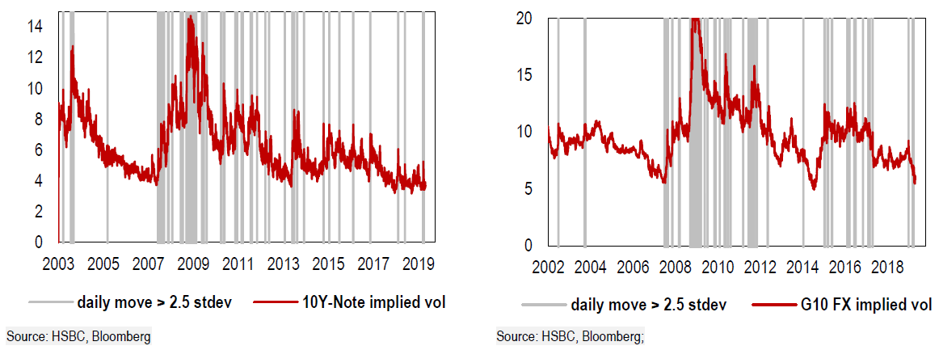
Heightened gap risk
31.
10Y T-Note implied vol
G10 FX implied vol

Slide 32
32.
GBP and politics: when two becomes three

Slide 33
Framework for GBP forecasts – Deal or no deal
33.
No Deal
1.10
Deal
1.45
50%
GBP-USD
50%
1.25 – 1.30
Source: HSBC

Slide 34
34.
GBP cheap on … Deal or No Brexit
~1.60
~1.45
Source: HSBC, Refinitiv Datastream

Slide 35
35.
Framework for GBP forecasts – Deal or no deal
Deal
HSBC forecast
No Deal
Source: Bloomberg, HSBC

Slide 36
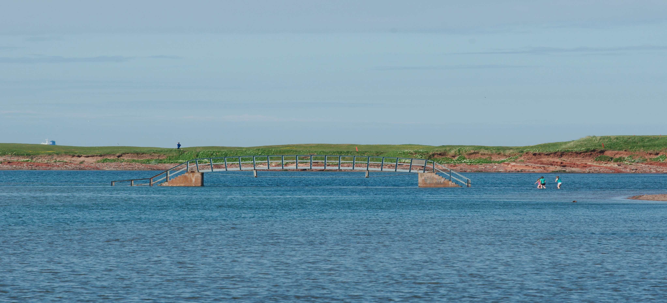

No Deal
Deal
No Brexit
Deal
No Brexit
1.10
1.45
1.45
1.55
1.55
100%
50%
33%
1.32
0%
1.30
1.37

Slide 37
37.
No big shift in public opinion
Source: WhatUKthinks.org

